Slide 1

MK130 – Genetics of Crop Diversity
Phenotypic and genotypic evaluation of B. napus accessions
Alisa Anjulie Röring
Sam Johnson

Slide 2
Goal of the project
Overall:
Select 3 accessions that combine both adaptability and genetic diversity for a future OSR breeding project
Adaptability:
How good is the overall phenotypic performance of each accession?
Diversity (from genotyping):
How genetically different are the accessions from each other?
Notes:
If you prefer you can do the introduction and say a bit about how we separated Pheno and Geno and why both are important.
If you are not comfortable doing the introduction i can do it too so dont worry about it <3
The goal of this project was to select three accessions that would be suitable donors for a future winter oilseed rape breeding program
To do that, the accessions were evaluatated in 2 complementary ways.
On one hand, we looked at adaptability, meaning their overall phenotypic performance across multiple traits
Second, we looked at genetic diversity using SNP data which tells us how genetically different the accessions are from each other

Slide 3
Phenotypical evaluation: Traits
Growth & development:
Plant height, BBCH
Excluded: Flowering time
Biomass:
Fresh mass, dry mass
Yield component:
Hundred grain weight
Physiology:
CCM
Seed quality:
Proteins, oil, glucosinolates etc.
Notes:
There are a few things I‘d like to address regarding the phenotypical traits we measured:
We ran a linear mixed model to test whether genotypes have a significant effect on each trait
This was the case for all traits except flowering time, where in only 2 cases the genotype had a significant effect but those were accessions that aren‘t of interested to us so we left it out
For seed quality we z-standardized the traits to make them comparable, assigned good traits and bad traits and calculated a seed quality index based on that

Slide 4
What are BLUPs and EBLUPs?
BLUP:
Corrected genetic value
Removes environmental + replicate effects
EBLUP:
Overall mean + BLUP → final corrected performance of each genotype
Notes:
So in order to understand what we did it‘s important to know what BLUPs and EBLUPs are so I will quickly cover that before moving on
BLUPs are the predicted genetic effects of each genotype. They represent how much a genotype deviates from the overall mean, after correcting for environmental effects such as replication.
eBLUPs are the predicted genotypic values: the overall mean plus the BLUP of each genotype.
They give the final, corrected performance value for every accession
Why use them? -> They are clean, noise reduced values for ranking and multi-trait scoring

Slide 5
Phenotypical evaluation: Pipeline
Testing genotypes for significance using LMMs
  Model: Trait = Genotype + (1 | Rep)
Extracting BLUPs and EBLUPs
  Model: Trait = 1 + (1 | Genotype) + (1 | Rep)
Calculating multi-trait score using EBLUPs
Ranking accessions after overall performance
Notes:
As mentioned before we tested for each trait whether the genotype has a significant effect, We used a linear mixed model with geotype as fixed and replications as a random effect
we then extracted the BLUPs usig a model where both genotype and replications are random, but the overall mean is fixed.
We then used the eblups of all measured traits to calculate the multi trait score.
This is done by standardizing all values to make them comparable and adding them together.
In the end each accession has one overall adaptability score which reflects its performance across phenotypic traits

Slide 6
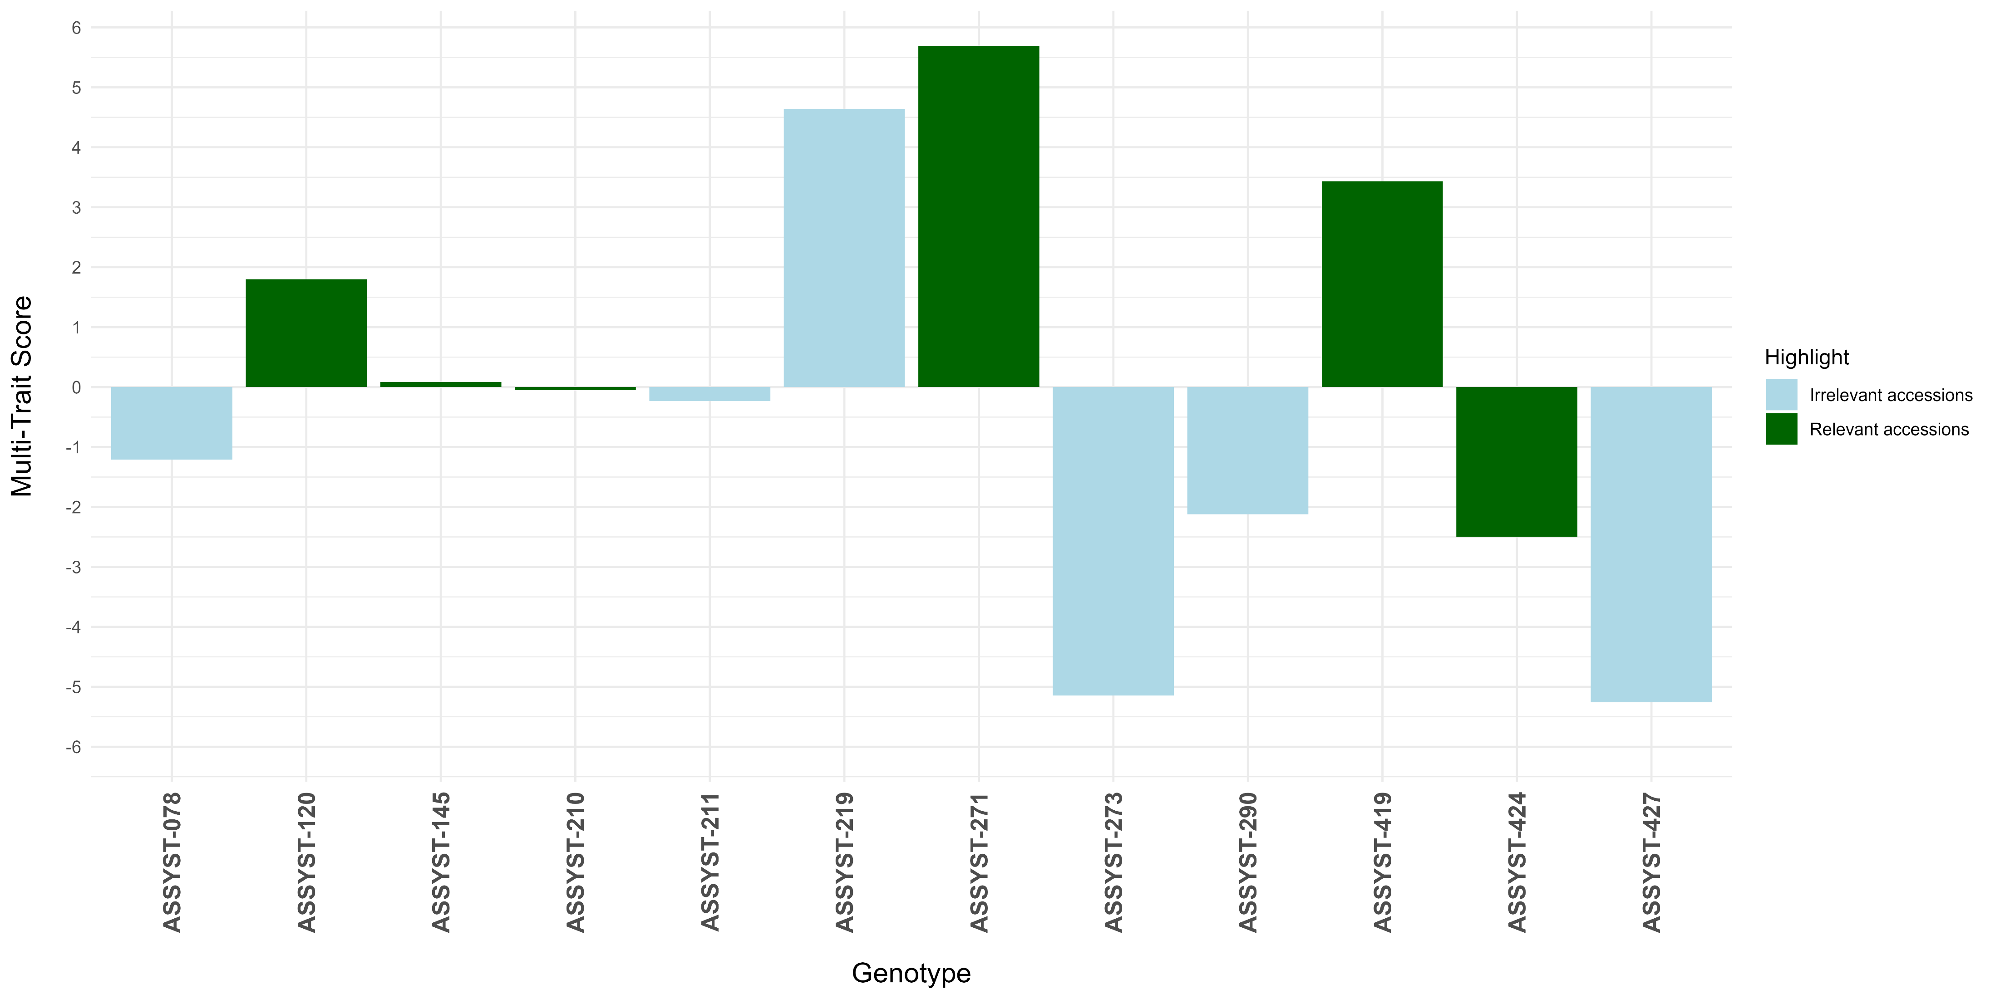
Phenotypic evaluation: Results
Notes:
Overall, ASSYST-271, a spring oilseed rape, performs best regarding phenotypical traits. Runner up is 219, which is a siberian kale and on third place we have 419, a swede.
The worst performing accessions are 273, a spring oilseed rape and 427, a swede.
The results highlight that the genotype does in fact have a significant effect on the performance, not just across all types but also within, as can be seen with 271, the top performer and´273, both summer oil seed rapes.
If we were only looking at adaptability, the obvious choices would be 271, 419 and 120 but since we are also interested in genetic diversity, our final choice looks quite different, and Sammi is going to tell you all about that
This is where you come in :D

Slide 7
Methods Geno
KASP (explain AA and CC)
  Possible cryptoheterozygosity in CC (R7 | R9)
  Still best for disease resistance
  AA second best (only resistant to <race of L. maculans>, some fungi work around this PAMP), but can confirm homozygosity
Genetic uniformity dangerous
Explain axes of PCA
  Highlight our selections and why
  Why does that matter?

Slide 8
Methods Geno (cont'd.)
Explain how these results let us confidently pick our 3 accessions of the 6
We saw that the observed hetero was higher
Maybe a table of performance vs alleles (lmv) vs PCA

